Slide 1

Load/Performance/Stress Testing Web Services
www.pragmatic.bg
Lector: Dimitar Topuzov
E-mail: dtopuzov@gmail.com
LinkedIn: http://bg.linkedin.com/pub/dimitar-topuzov/18/470/833/en
Copyright © Pragmatic LLC 2016

Slide 2
Content
Jmeter Theoretical Intro
How it works
Installation
Elements
Thread Group
Samplers
Listeners
Configuration Element
Plugins
Demos

Slide 3
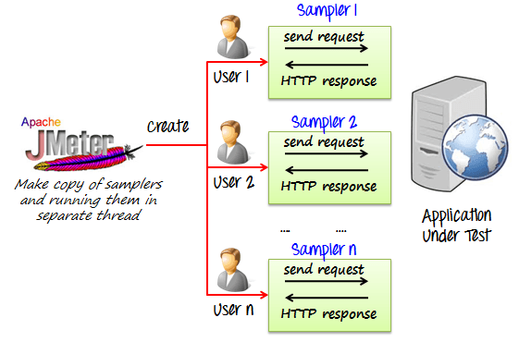
Load Testing with JMeter
How JMeter Works

Slide 4
Load Testing with JMeter
Requirements
JDK 1.6 +
Hardware: Depends on what we want to simulate
Installation
Install JDK
Add JDK to Path (if not already added)
Verify installation by running “java -version” on command prompt
Install JMeter
Download
Extract
(Optional) Add to Path

Slide 5
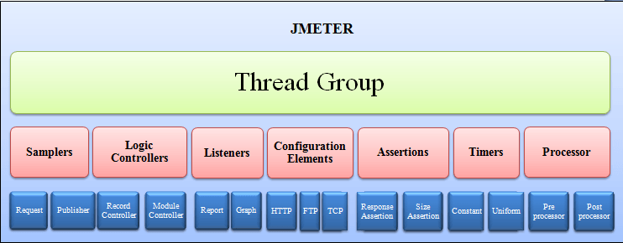
Load Testing with JMeter
JMeter elements schema

Slide 6
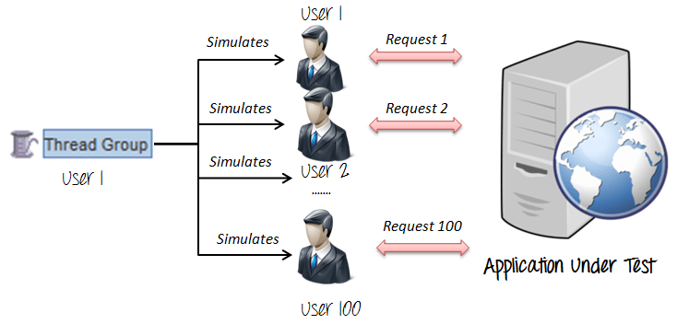
Load Testing with JMeter
Thread Group
Thread Groups is a collection of Threads
Each thread represents one user using the application under test

Slide 7
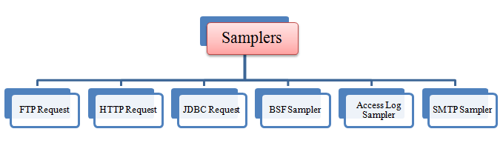
Load Testing with JMeter
Samplers
Sampler is type of Request (Protocol) we want to use in our tests
HTTP, FTP , JDBC, POP3 …

Slide 8
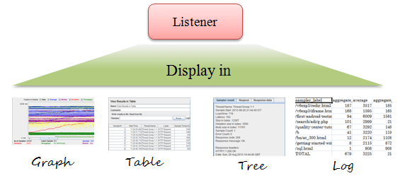
Load Testing with JMeter
Listeners
Shows the results of the test execution
They can show results in different format such as tree, table, graph or log file

Slide 9
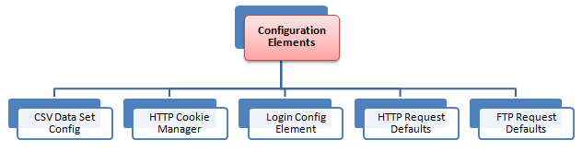
Load Testing with JMeter
Configuration Element
Set up defaults and variables for later use by samplers

Slide 10
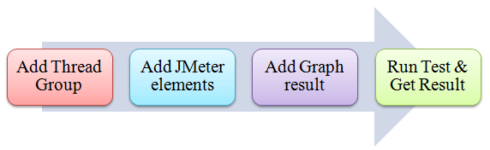
Load Testing with JMeter
JMeter project workflow

Slide 11
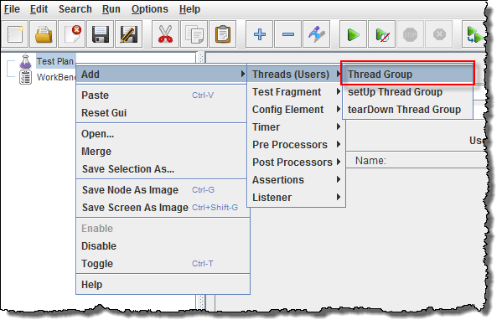
Load Testing with JMeter
Add Thread Group
Start JMeter
Select Test Plan on the tree
Right click on the Test Plan and add a new thread group: Add -> Threads (Users) -> Thread Group

Slide 12
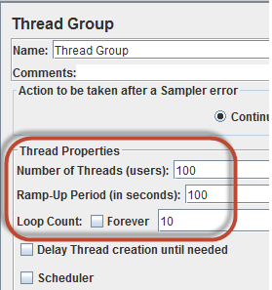
Load Testing with JMeter
Thread Group Properties
Number of Threads
Number of users connects to target website/service
Loop Count
Number of time to execute testing
Ramp-Up Period
Delay before starting next user

Slide 13
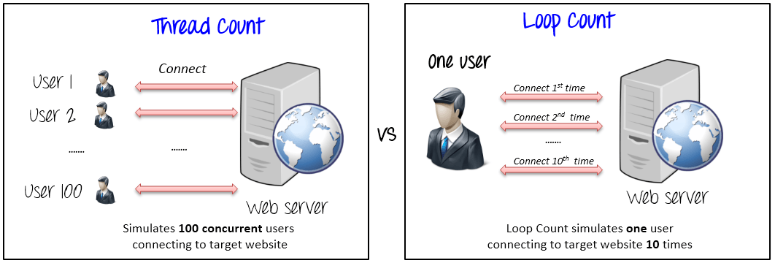
Load Testing with JMeter
The Thread Count and The Loop Counts are different

Slide 14
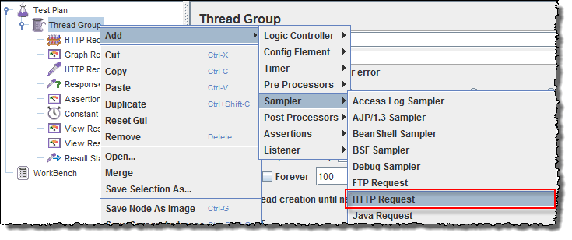
Load Testing with JMeter
Adding JMeter elements
Right-click on Thread Group and select: Add -> Sampler -> HTTP Request.

Slide 15
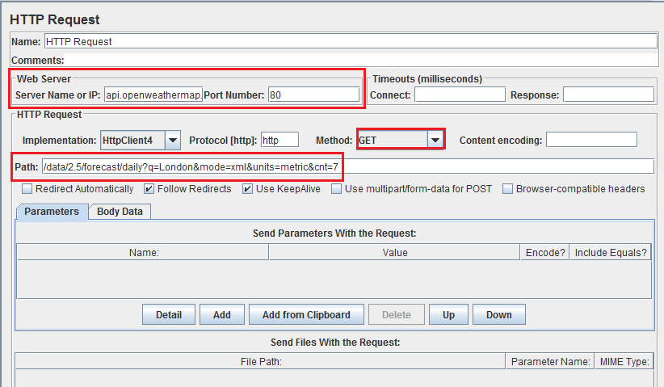
Load Testing with JMeter
HTTP Request

Slide 16
Load Testing with JMeter
How to use Timers in Jmeter
Constant Timer
Thread Group -> Timer -> Constant Timer
Delays each user request for the same amount of time
Gaussian Random Timer
Gaussian random timer delays each user request for a random amount of time
Uniform Random Timer
Uniform random timer delays each user request for a random amount of time.

Slide 17
Load Testing with JMeter
How to use Assertions in JMeter
Assertion help verify that your server under test returns the expected results.
Commonly used Assertion in JMeter
Response Assertion
Thread Group -> Add -> Assertions -> Response Assertion
Assert Response contains Text
Assert Response Status Code is correct
Duration Assertion
Size Assertion
XML Assertion
HTML Assertion

Slide 18
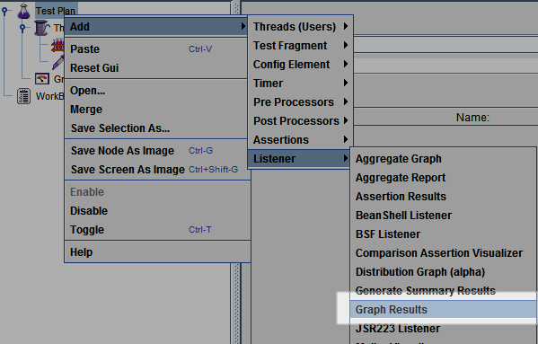
Load Testing with JMeter
Adding Graph Results
Right click Test Plan, Add -> Listener -> Graph Results

Slide 19
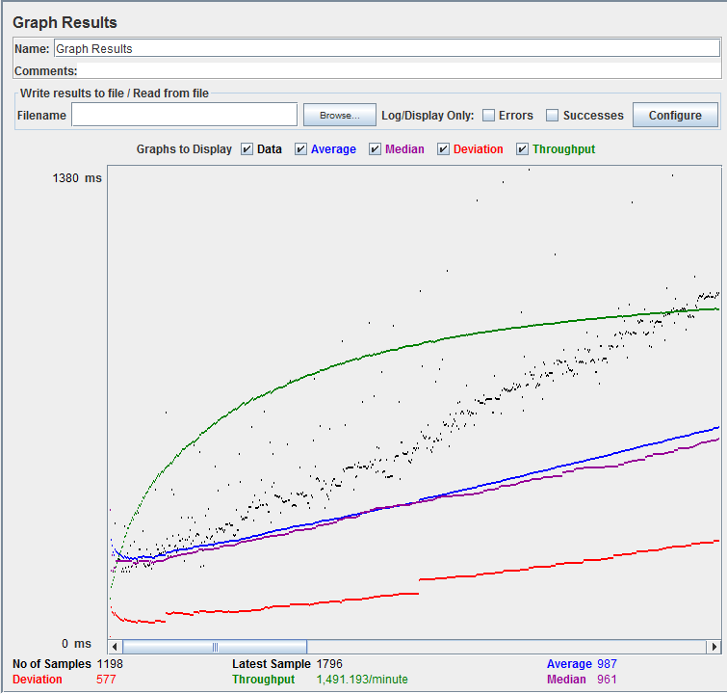
Load Testing with JMeter
Run Tests and get results
Press Run button (Ctrl + R) on Toolbar to start the testing process. You will see the test result display on Graph at the real time.

Slide 20
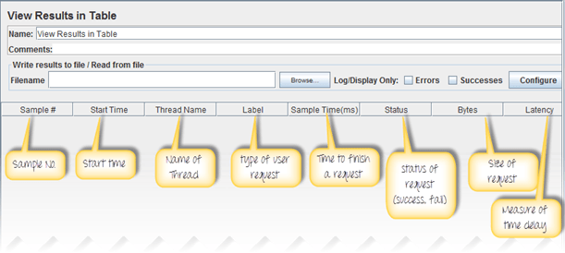
Load Testing with JMeter
View Results in Table
Right click Add -> Listener -> View Result in Table

Slide 21
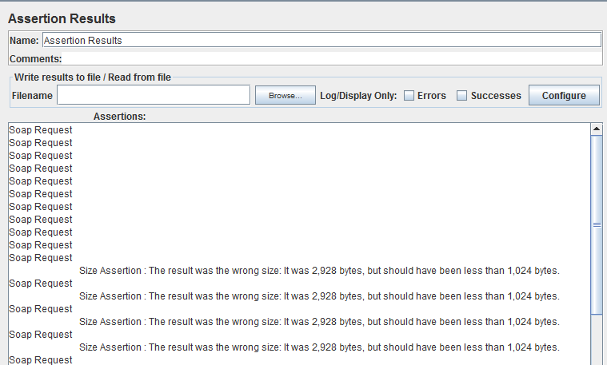
Load Testing with JMeter
View Assertion Results
Right click Thread Group, Add -> Listener -> Assertion Results

Slide 22
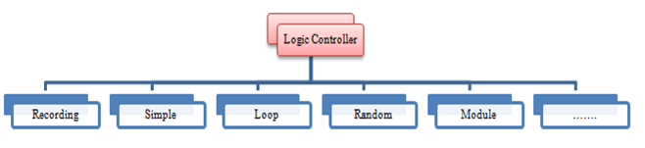
Load Testing with JMeter
Logic Controllers
Logic Controllers let you define the order of processing request in a Thread
Logic Controllers determine the order in which user request are executed

Slide 23
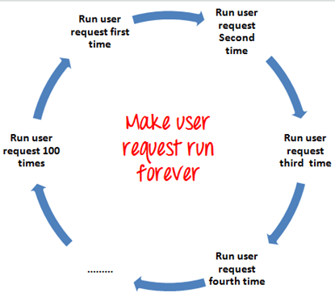
Load Testing with JMeter
Loop Controller
Loop Controller makes the user request run specified number of times or run forever as shown in figure

Slide 24
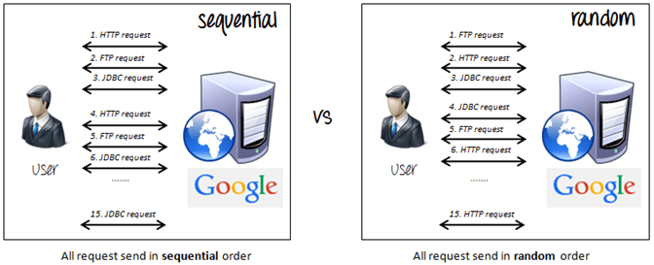
Load Testing with JMeter
Random Controller
Random Controller makes all the user requests run in random order in each loop period

Slide 25
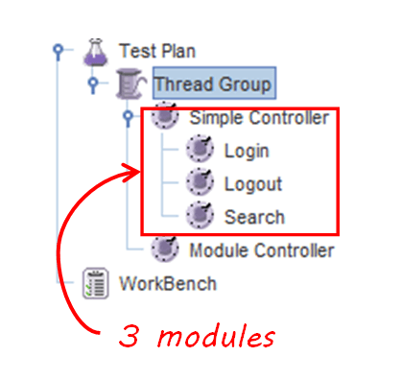
Load Testing with JMeter
Module Controller
The goal of Module Controller is to add modularity to JMeter

Slide 26
Load Testing with JMeter
Hints for Reducing Resource requirements
Use non-GUI mode: jmeter -n -t test.jmx -l test.jtl
Use as few Listeners as possible; if using the -l flag as above they can all be deleted or disabled.
Use CSV output rather than XML
Only save the data that you need
Use as few Assertions as possible

Slide 27
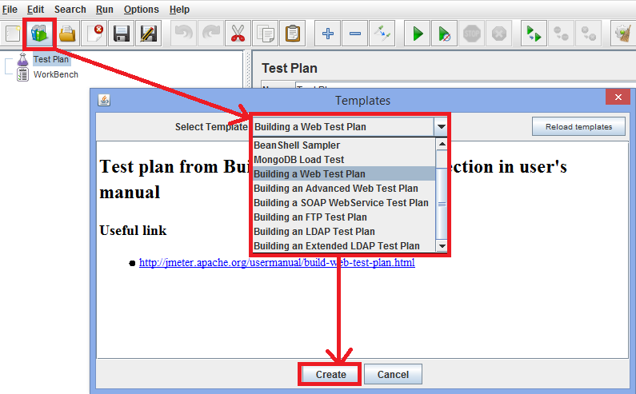
Load Testing with JMeter
Build-in Templates

Slide 28
Load Testing with JMeter
Plugins
JMeter Plugins
PerfMon Metrics Collector and Server Agent can be used for automated monitoring of servers during load/stress test

Slide 29
Tips
Jmeter 3.0 has a lot of new features, but also some deprecated
See http://jmeter.apache.org/changes.html
SOAP/XML-RPC Request deprecated (was available in 2.9)
Be careful with asserts
Asserts slow down your machine
Be careful with reports
Asserts slow down your machine
In production try to use only csv reports
Notes:
protocols

Slide 30
Tutorials
Official Documentation
The Ultimate Jmeter Tutorial
Tutorial for Distributed Load Testing
Notes:
protocols

Slide 31

Questions

